Slide 1
Terminology Review
clock cycle - the basic unit of time for processor activity.
Instruction/machine cycle - (also called fetch-and-execute cycle, fetch-decode-execute cycle) is the time period (measured by the number of oscillator clock cycles) during which a CPU processes a machine language instruction from its memory.

Slide 2
8051 Machine Cycle
8051 being mostly CISC processor, has (about 255) instructions of varying lengths and machine cycles.
Instructions require 1,2 or 4 machine
cycles.
Two oscillator pulses define one state
and 6 states (i.e 6x2=12 clock cyles) define a machine cycle.

Slide 3
8051 Basic Machine Cycle/Instruction cycle
P1
P2
P1
P2
P1
P2
P1
P2
P1
P2
P1
P2
P1
P2
State1
State 2
State3
State 4
State5
State 6
One machine cycle

Slide 4
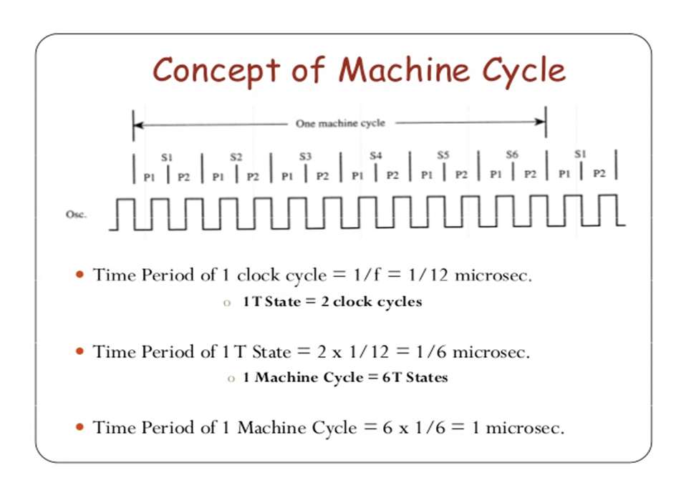

Slide 5
1/f gives the pulse time P
Hence Time taken for executing an 8051 instruction is
T(inst) =(cycles x 12) / freq
If 12MHz crystal frequency, 1 MC time is 1 us.
If 11.0592MHz crystal frequency, 1 MC time is 1.085 us.
www.vectorindia.org

Slide 6
PSW Special function register
7 6 5 4 3 2 1 0
CY AC FO RS1 RS0 OV - P The remaining two user
flags will be in PCON
Bit Symbol Function
7 CY Carry flag;used in arithmetic,jump,rotate,and Boolean instructions
6 AC Auxiliary Carry flag used for BCD arithmetic
5 F0 User flag 0
4 RS1 Register bank select bit 1
3 RS0 Register bank select bit 0
2 OV Overflow flag;used in arithmetic instructions
1 - Reserved for future use
0 P Parity flag;shows parity of register A:1 =Odd parity
Bit addressable as PSW.0 to PSW.7
www.vectorindia.org

